Slide 1
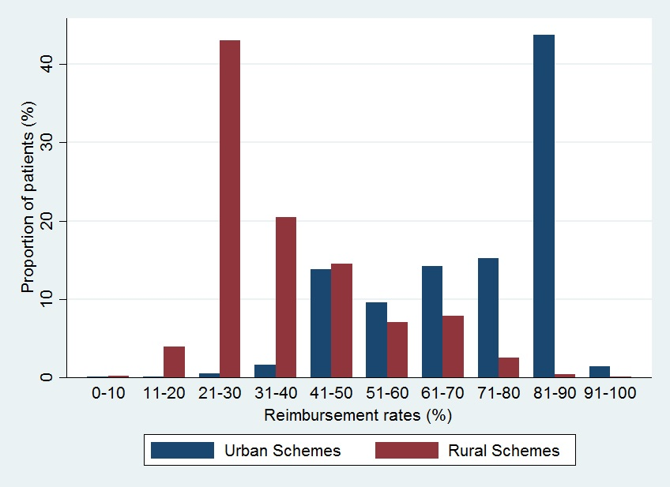
Fig. S1 Distribution of reimbursement rates among breast cancer patients covered by urban and rural insurance schemes. NOTE. Patients with missing information on either insurances type (N=147, 1.98%) or reimbursement rate (N=569, 7.65%) were not included in analysis.

